Slide 1

Learning to Talk to Developers Practical tips
Bryden Oliver
He/him
Solution Architect
SSW

Slide 2



Bryden
Oliver
He/Him
Solution Architect
I’m a Cloud Solution Architect with over 25 years of professional experience. I have a wealth of knowledge from a diverse range of areas but with particular focus on databases, web services, Microsoft Azure and SaaS based solutions.
Currently I'm working at SSW, a software consultancy in Brisbane, Australia.
SSW
@brydenoliver
www.ssw.com.au/people/bryden-oliver
www.linkedin.com/in/brydenoliver

Slide 3

Table of Contents
Introduction
What are the issues
Fix the Culture
Developer Knowledge
DBA Knowledge
Plan for Success
Notes:
Should be 3:30

Slide 4


Introduction
DBAs and developers struggle to talk
It seems to be more of a problem now
Why is this
How can we improve

Slide 5
Introduction
What are the issues
Fix the Culture
Developer Knowledge
DBA Knowledge
Plan for Success
Notes:
3:30
Should be 6:00

Slide 6

Training
Developers training has changed
Much more broad
Much less deep
Databases used to be significant part of education
Databases now a small topic

Slide 7
The developer tooling has changed
Harder for DBAs to keep up
Often less control for both

Slide 8

Organization
Higher expectations
More responsibilities
Competing priorities
More reactive
Less proactive

Slide 9
Modern development methodologies
Small cross functional teams
Typically broad knowledge
Discourages depth

Slide 10

Incentives
How is developer success measured
How is DBA success measured
Often at odds, ie what the business tells one group is success makes the others job harder

Slide 11

Timelines and planning
DBAs brought in late
Mistakes have already been made

Slide 12
Introduction
What are the issues
Fix the Culture
Developer Knowledge
DBA Knowledge
Plan for Success
Notes:
9:30
Should be 10 minutes

Slide 13

Developers
How is developer success measured
Typically on whether the application works
Not on shared system costs, ie database or DBA time

Slide 14
DBAs
How is DBA success measured
Typically not on the success of projects that are deployed
Often on keeping the infrastructure cost low and minimising outages

Slide 15

Be Proactive
Involve DBAs early
Often the DBAs are brought in once the app is written
DBAs provide much more value than just deploying and maintaining databases
Get involved the application design

Slide 16

Be useful
Be around during dev
Help teams design application
Application will be better
Maintenance will be reduced

Slide 17
Sell this to your team as investing time now to reduce headaches later
Maintenance is often unplanned and stressful
Much better to avoid it with better upfront planning

Slide 18
Fixing bugs/issues early
Research shows this dramatically reduces cost
Finding bugs in production is 30 times more expensive than at design time
You have expertise that is missing at design time. So…

Slide 19

Management
Measuring how well the team works together
Look at the quality
Set realistic goals for the organisation not individuals

Slide 20
Now we know what’s wrong
Need to engage managers
They need to drive change
We need to propose it
This will probably involve several managers

Slide 21

Be clear about the problem
Propose part of a solution
Ask for help with a proposal
A good manager will be able to provide great assistance and advice

Slide 22

Remember raising these sorts of issues is good
It can aid with career progression
And it will make your life easier

Slide 23
Process change takes time
Build support for change
Start on other things too

Slide 24
Even if you can’t fix process
Engaging directly with developers will help
Build a rapport with everyone involved

Slide 25
Introduction
What are the issues
Fix the Culture
Developer Knowledge
DBA Knowledge
Plan for Success
Notes:
15:00
Should be 19:30

Slide 26
Developer knowledge
It's hard communicating an application's effect on a server
Because developer's don't see databases much in their training
Development is very broad
Generally only covers a little of how to read/write data

Slide 27
So we need to provide the basics
Start with some background
Find some analogies

Slide 28

I find starting with a pile of old style library index cards is good
A table works as 1 row per card, each column on a particular row on the card

Slide 29
Demo
Gimmicks help recall
Fun helps retain attention
Start simple and build
Mangling words or phrases helps recall

Slide 30

Name: Kangaroo
Size: Large
Dangerosity: Moderate
Venomosity: 0
Notes: Renowned for jumping and boxing

Slide 31

Name: Taipan
Size: Large
Dangerosity: Very high
Venomosity: 10
Notes: World’s most venomous snake. Aggressive. Lives in remote areas far from first aid.

Slide 32

Name: Box Jellyfish
Size: Small
Dangerosity: Medium-High
Venomosity: 9
Notes: Very painful stings. Venom can kill. Rinse with vinegar if stung.

Slide 33

Name: Echidna
Size: Medium
Dangerosity: Low
Venomosity: 0
Notes: Eats ants. Spikes are sharp, but only rolls into a ball for protection, not used as a weapon

Slide 34

Name: Platypus
Size: Small
Dangerosity: Low
Venomosity: 2
Notes: Babies are super cute. Oddest animal. Has venomous spurs on back legs.

Slide 35
Start with a pile of say 50 cards
First of all assume they are not in order
Demonstrate how long you take to find the one you want
Then order them by one of the columns
Now they understand rows and Primary Keys clearly

Slide 36
Indexes are like library indexes
Have another card stack which is sorted based on another column and includes the key back to the main table.
If there’s information that’s really useful when using that index, ie fills lots of potential questions, “include” it on the index cards
Now we’ve covered Indexes and included columns

Slide 37
Demo
Watch for the following this time: Gimmicks help recall
Fun helps retain attention
Start simple and build
Mangling words or phrases helps recall

Slide 38

This analogy in particular is really good
It continues working for other cases too
Partitioning
Cost of a query

Slide 39
Introduction
What are the issues
Fix the Culture
Developer Knowledge
DBA Knowledge
Plan for Success
Notes:
17:00
Should be 34:30

Slide 40

DBA Knowledge
Typical dev errors
ORMs

Slide 41

ORMs
Object-Relational Mapping (ORM) is a technique that lets you query and manipulate data from a database using an object-oriented paradigm.
Microsoft’s Entity Framework is the most popular

Slide 42

It gives you plenty of rope
Devs have a habit of using that rope to hang themselves
ORMs let them write database queries, almost without thinking
Results in a tendency to think that was such little code it couldn’t be expensive

Slide 43

Common issues
One of my colleagues JK lectures on this a lot
Well worth watching
https://www.youtube.com/watch?v=x4TumMHiB6w
He’s talking to devs about what they normally do wrong

Slide 44
Get only the rows needed
Get only the columns needed
Pagination
Non-cancellable queries

Slide 45
Get only the rows needed
Grab your index cards again
Really easy for people to understand if you talk about instead of handing over 1 card, you hand over the box
Get devs to tag queries with useful info. Means when looking at expensive queries you can tell from the description if this is happening.
Most common is getting everything and then doing a filter or worse a count on the client

Slide 46
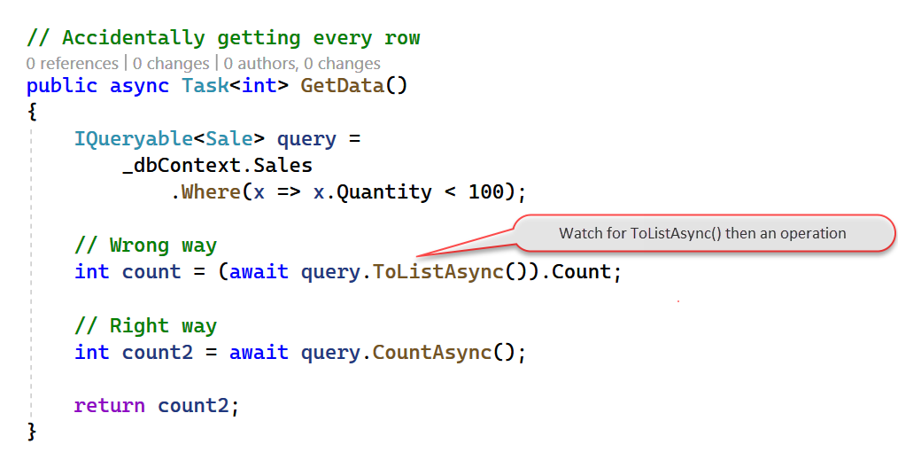
Code Example

Slide 47
Get only the columns needed
Similar to the previous
Often they’ll do “Select * from”
Or include all columns in a join instead of the single one desired.
Look for excessive joins and really “wide” result sets
ORMs often have a method called Include (which does a join), Devs often forget how big this is.

Slide 48
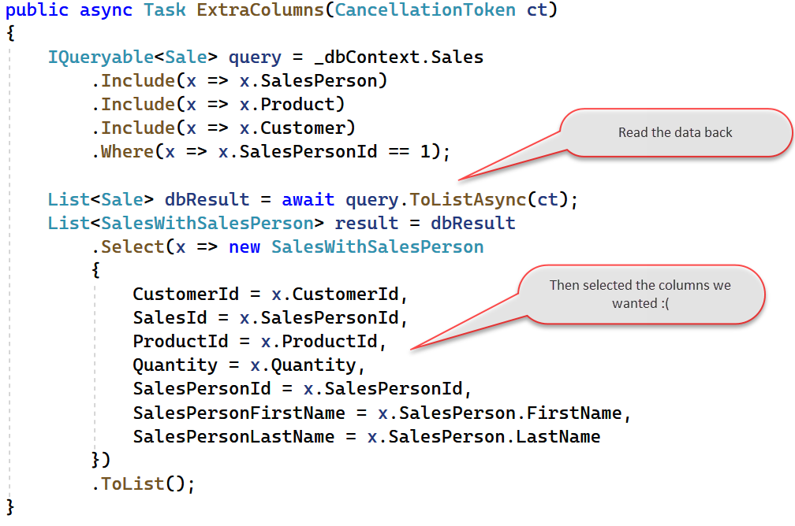
Code Example (Bad)

Slide 49
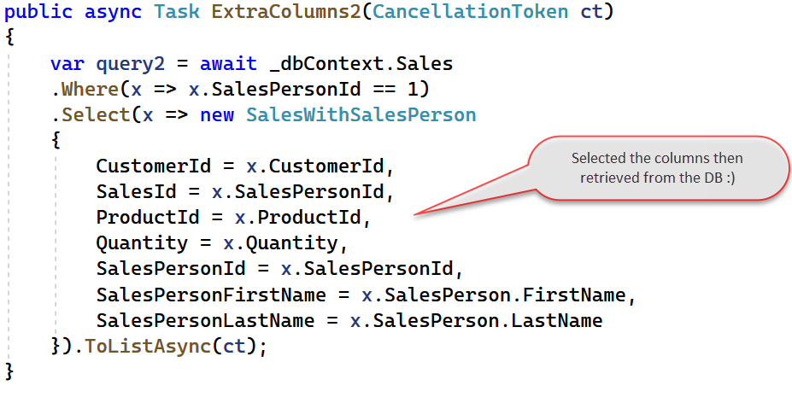
Code Example (Good)

Slide 50
Pagination
Get the total row count separately
Make sure the “page” of rows is selected on the server

Slide 51
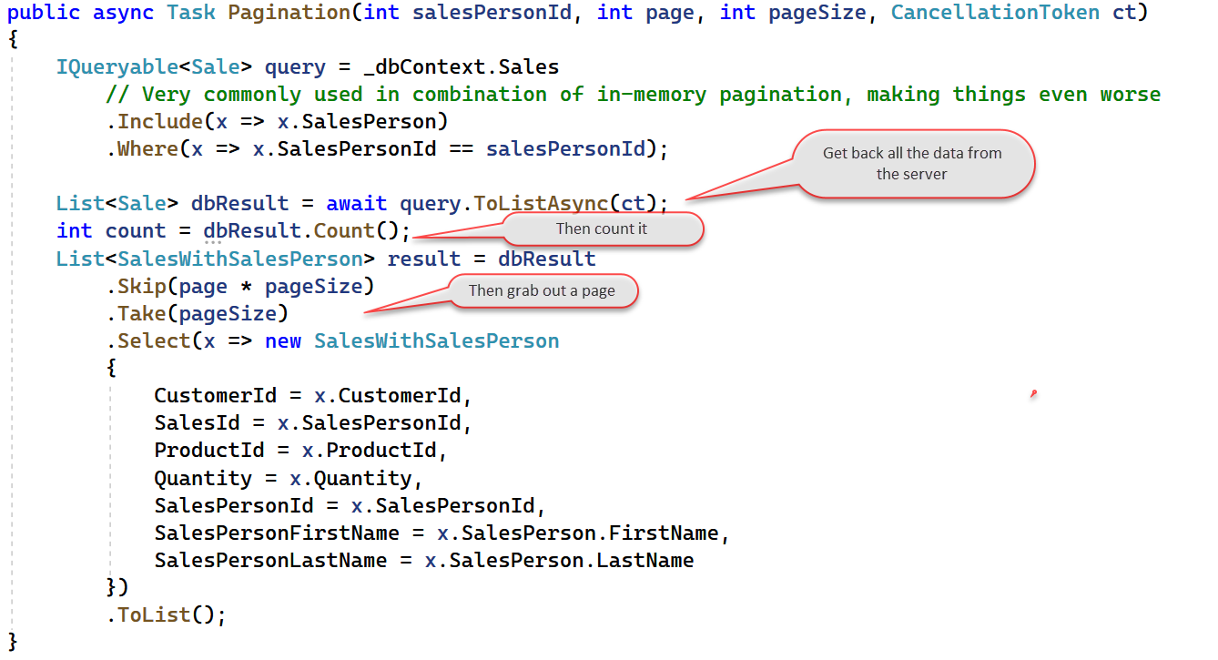
Code Example (Bad)

Slide 52
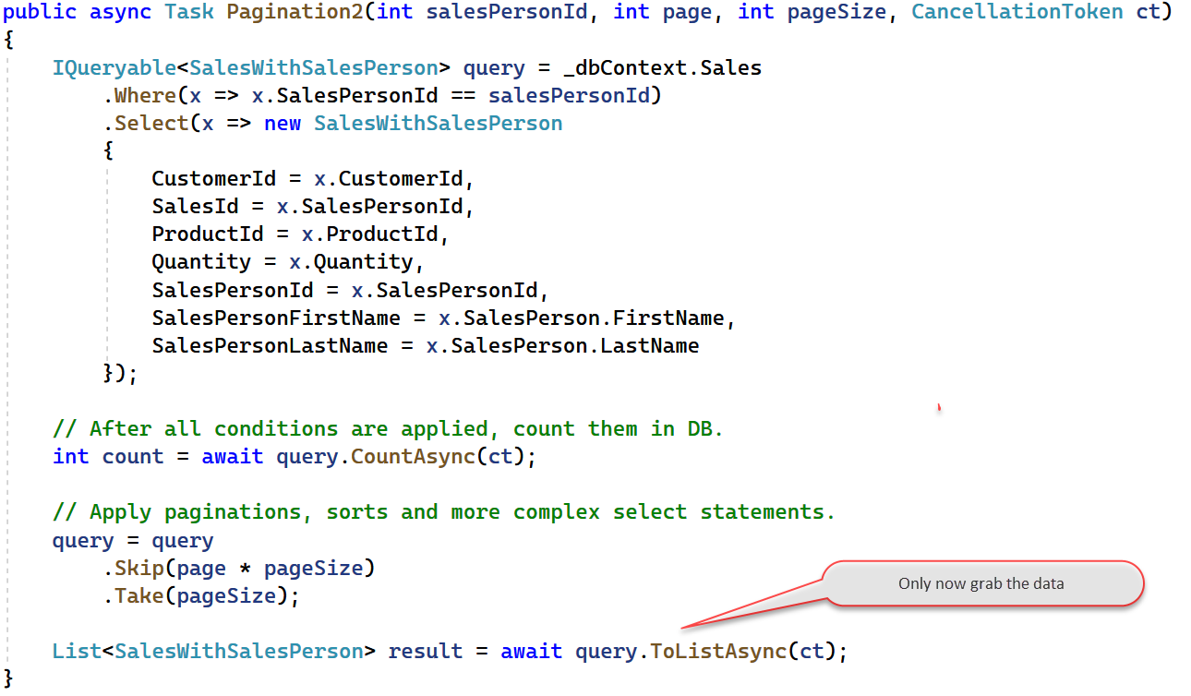
Code Example (Good)

Slide 53

Non cancellable queries
If you see long running queries, ask devs can they be stopped
Very common that if the user gives up, that the query doesn’t get cancelled

Slide 54
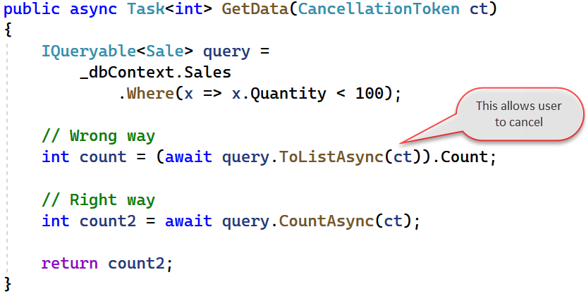
Code Example

Slide 55
Introduction
What are the issues
Fix the Culture
Developer Knowledge
DBA Knowledge
Plan for Success
Notes:
4:00
Should be 51:30

Slide 56
Plan for success
Organizational change will take time
Start that process

Slide 57
Be clear and concise
Clearly describe the problem
Always avoid blame

Slide 58
Now you know what to look for
Teach the devs

Slide 59
Given sprint based development
Meet regularly

Slide 60

Having a review of all data access code once a sprint is very valuable

Slide 61
Start by walking through a problem
Stop to explain things
Over time, there will be less to review

Slide 62

Make monitoring accessible
Devs will want query cost, rows returned and SQL
Teach them to get this

Slide 63
Teach them simple SQL, so they understand issues

Slide 64
So far we’ve just covered queries
Updates are often less of an issue BUT

Slide 65
If it is an issue
Time to talk about locking, transactions and blocking

Slide 66
They will really need your help for these types of issues

Slide 67
Summary
Notes:
2:00
Should be 55:30

Slide 68
Get management on board
Have fun together

Slide 69

Build relationships
Teach each other

Slide 70
Meet regularly
Review small changes

Slide 71
Remember clear and open communication is key
Bryden Oliver
@brydenoliver
www.ssw.com.au/people/bryden-oliver
www.linkedin.com/in/brydenoliver

